Slide 1

Working Prototype Summary
20 April 2026
By Built Different

Slide 2
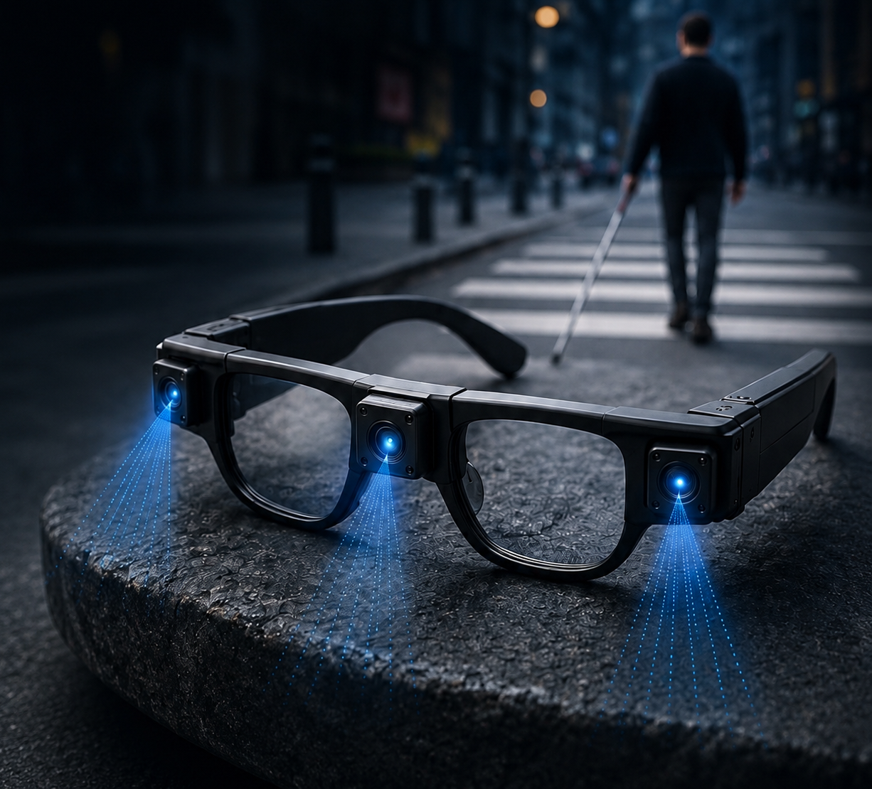
Project Goal
Real-time obstacle detection for visually impaired users
Audio feedback via directional buzzers (Left / Center / Right)
Using Time-of-Flight (ToF) sensors + ESP32
Currently on breadboard, moving toward fully portable hat-mounted version

Slide 3
Sensors & Core Components
Component | Quantity | Notes
VL53L1X ToF Sensors | 3 | Left, Centre, Right
ESP32 | 1 | Development board
Active Buzzers | 3 | Left, Centre, Right
Power Supply | 1 | 5V

Slide 4
Wiring & Connectors
Component | Quantity | Usage
Male-to-female jumper wires | +- 20 | ESP32 → Breadboard
Female-to-female jumper wires | +- 20 | Sensor daisy-chaining
Full-size breadboard | 1 | Main board
Mini breadboards | 3 | One per sensor

Slide 5
Components Not Currently Used
Component | Reason
Vibration Motors | Skipped for now
ESP32-CAM | Phase 2
Arduino Uno | Backup and testing

Slide 6
Next Steps & Additions
Component | When
Boost converter + batteries | Face-mounted implantation
ESP32-CAM | Final implementation
Vibration motors | Silent haptic feedback

